Slide 1




CSE424 (PATTERN RECOGNITION)
COMPARATIVE EEG ANALYSIS BETWEEN Machine Learning and Deep Learning Models for Mental
Disorder Detection
CSE424

Slide 2



OUR GROUP
Faiyaz Bin Yousuf
Asief Iqbal Dieyaz
ID-22101845
ID-23341081
GROUP-11
Group-11

Slide 3
CSE424
1 | Abstract
2 | Introduction
3 | Background and Literature Review
4 | Collected Data
5 | Proposed Methodology
OUTLINE

Slide 4

ABSTRACT
Objective: Comprehensive analysis of EEG models for specific mental disorder detection.
Dataset: EEG signals from schizophrenic patients.
Models: Logistic Regression, KNN, SVM (Linear and RBF), Random Forest, XGBoost, Decision Tree, and CNN.
Feature Extraction: Signal processing techniques.
Evaluation: Assessment on accuracy, precision, and recall.
Insights: Explore efficiency in mental disorder detection using EEG data.
CSE424

Slide 5

INTRODUCTION
Mental Health Snapshot | WHO identifies Schizophrenia as a major global cause of disability. Non-invasive methods, like EEG analysis, gaining attention for detection.
Research Objective | Targeting schizophrenia using EEG signals.
Study Framework | Goal: Compare models (Logistic Regression, SVM, Random Forest, XGBoost, KNN, CNN). Evaluation based on accuracy, precision, and recall.
Contribution | Insights into model performance for mental disorder detection. Contributes to leveraging ML for improved mental health diagnosis.
CSE424

Slide 6
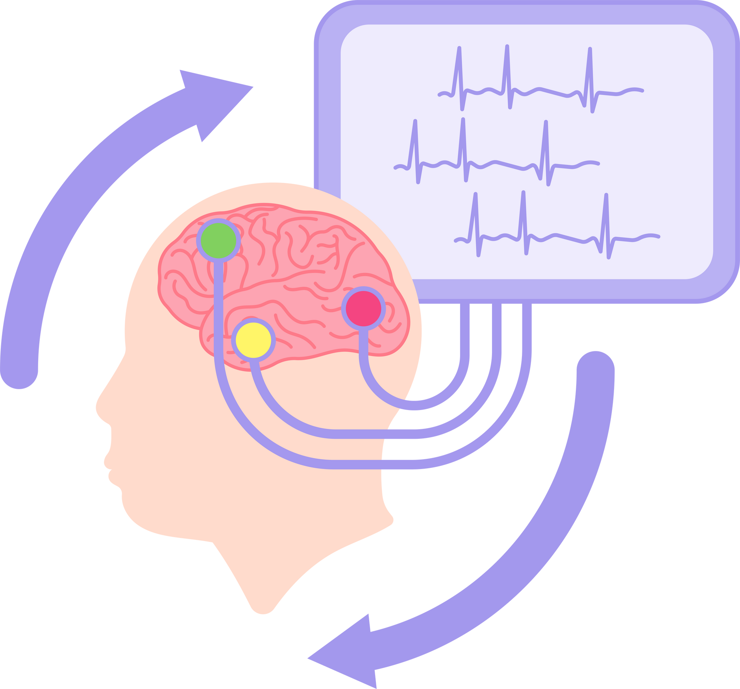
BACKGROUND AND LITERATURE REVIEW
Growing Interest in EEG:
EEG emerged as a powerful tool for mental disorder detection.
The shift from subjective methods to objective and quantitative measures.
Schizophrenia Detection (Devia et al., 2019):
EEG recordings during free-viewing tasks for schizophrenia diagnosis.
Significant differences in occipital areas as potential biomarkers.
Classifier development shows promising sensitivity and specificity.
CSE424

Slide 7

BACKGROUND AND LITERATURE REVIEW
Depression Detection (Saidi et al., 2020):
Hybrid CNN-SVM model for efficient depression detection.
Superior accuracy compared to the baseline CNN model.
Highlights the potential of combining CNN and SVM for enhanced accuracy.
EEG Connectivity Networks (Bougou et al., 2019):
Innovative architecture focusing on EEG connectivity patterns.
Effective connectivity measures using graph theory metrics.
Random Forest classifier achieves notable accuracy for schizophrenia classification.
CSE424

Slide 8

BACKGROUND AND LITERATURE REVIEW
Evaluation of Brain Connectivity using EEG (Olejarczyk, 2017):
Schizophrenia patients show reduced EEG connectivity and clustering.
Alpha band exhibits notable frequency-specific connectivity differences.
MRI indicates reduced white matter anisotropy and myelin in specific areas
Research Gap and Objective:
Existing studies lack a comprehensive comparative analysis across models.
This paper evaluates Logistic Regression, KNN, SVM, Random Forest, XGBoost, Decision Tree, and CNN.
Objective: Provide insights into strengths and limitations of models for specific mental disorder detection through EEG analysis.
CSE424

Slide 9
COLLECTED DATA
EEG Recording
Preprocessing
Analysis
Transformations
Frequency Bands
Duration: 15 minutes, eyes-closed resting state.
Channels: 19 EEG channels (10–20 montage).
Sampling Frequency: 250 Hz.
Selection of 30-second artifact-free segments.
Butterworth filter (order 2) for physiological bands.
Raw EEG data and re-referenced data were used.
Reference Electrodes: CSD, AVERAGE, REST.
CSD Toolbox: Laplacian estimators.
REST Toolbox: Reference electrode standardization.
Delta, Theta, Alpha, Beta, Gamma.

Slide 10
Segmentation
Signal Processing
Graph Theory Metrics
Data Filtering
Feature Extraction
Data Preprocessing
Dataset Analysis
Cross Validation
Detection of the mental disorder
Comparative Analysis Between the Models
PROPOSED METHODOLOGY
Hyperparameter Tuning
Model Training and Evaluation
Decision Tree
XGBoost
Model Selection
CNN
Random Forest
Logistics Regression
KNN
SVM
Random Forest

